Slide 1
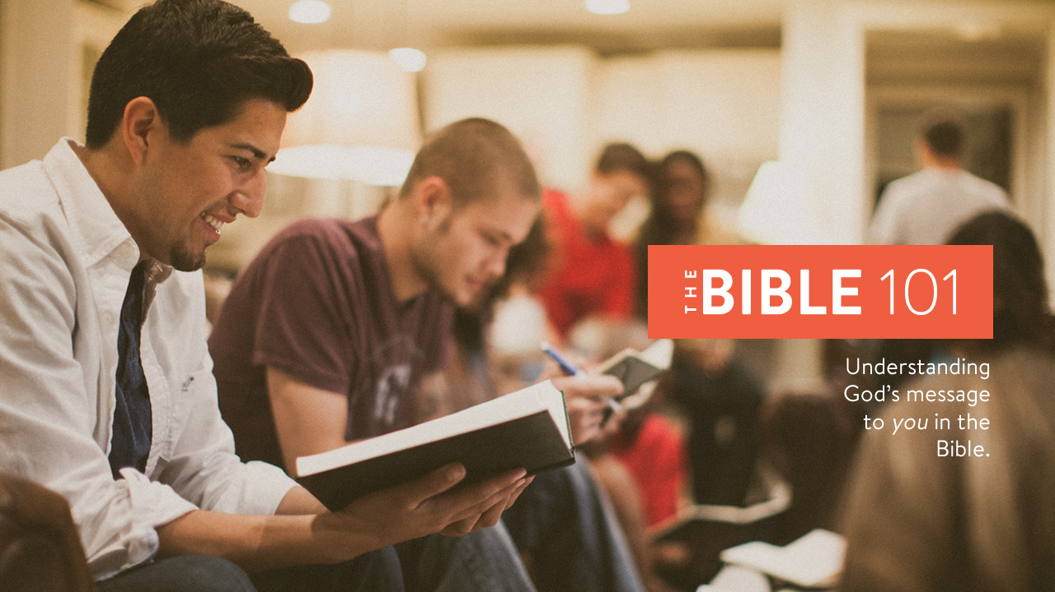
Notes:
Welcome to Lesson 4 of The Bible 101.
Make sure everyone has their notes sheet, pen, and Bible.
Open with prayer:
Father, we thank you for the opportunity to study your Word today. Our hearts are open and our minds are alert. We humbly ask you to open our eyes that we may understand the message you have sent to us, and give us a heart to obey it to the best of our ability. In Jesus’ name we pray, amen.
Thought: CS Lewis once said:
Christianity, if false, is of no importance, and if true, of infinite importance. The only thing it cannot be is moderately important.

Slide 2
Overview
Lesson 1
Lesson 2
Lesson 3
Lesson 4
The
Problem
The
Plan
The
Solution
The
Journey
Notes:
Overview of The Bible 101 course:
Lesson 1: The Problem. Why do we need saved? (Genesis)
Lesson 2: The Plan: God reveals His plan through the ancient nation of Israel. (Exodus- Malachi)
Lesson 3: The Solution: God sends His Son, Jesus Christ, to solve the sin problem. (Matthew - Acts)
Lesson 4: The Journey: Living the Christian life.
(Romans - Revelation)

Slide 3
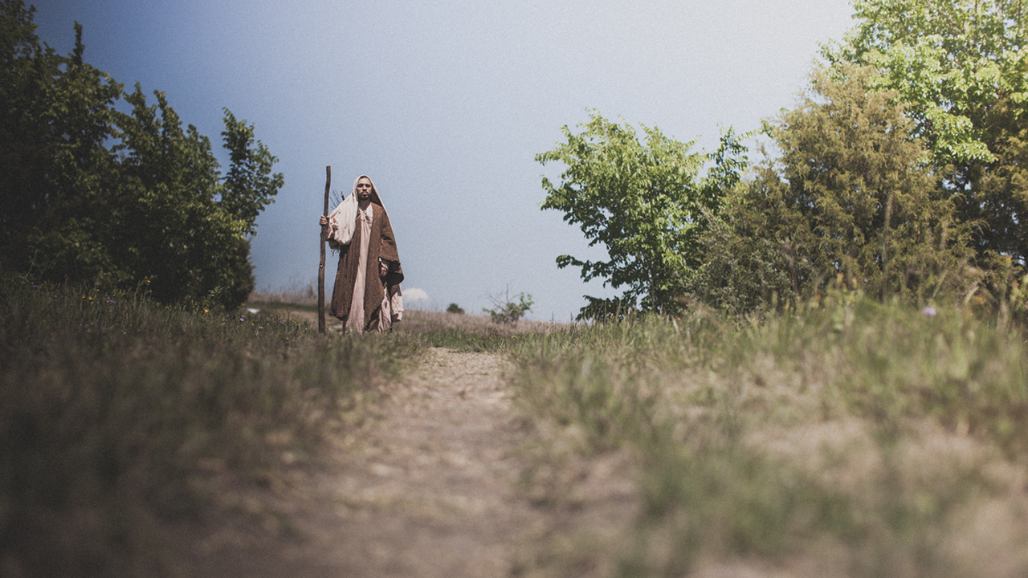
Review
Notes:
In lesson three we covered:
The four Gospels that tell the story of Jesus life.
The birth, life, death, and resurrection of Jesus Christ.
How to be born again into the Kingdom of God.
On the road to Emmaus, Christ revealed Himself to Paul in a vision:
He converted to Christianity.
He became the Apostle to the Gentiles. (non-Jews)
14 of the 27 books of the new testament were written by Paul.

Slide 4
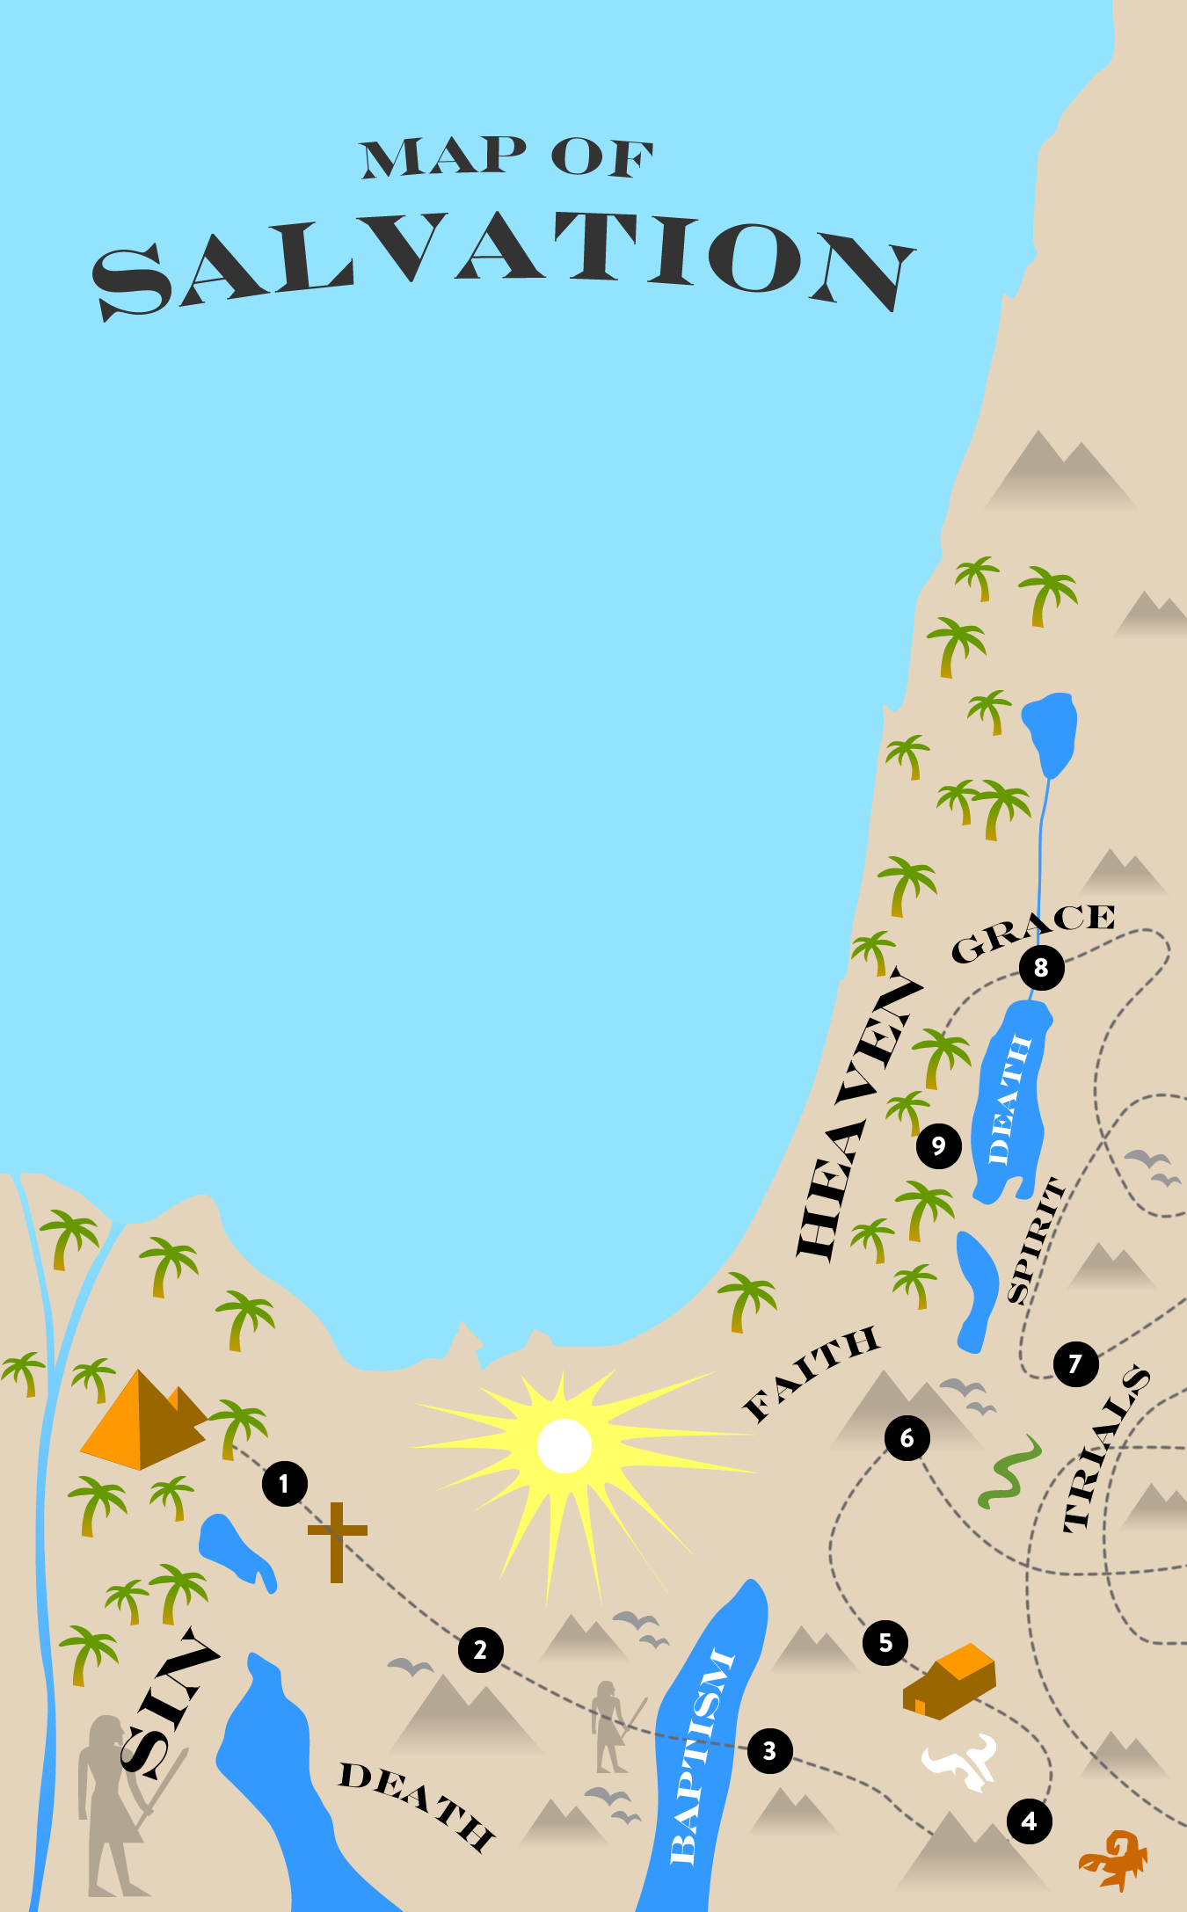
The Cross
Repentance
Baptism
The Word of God Protects
The Spirit Leads
Faith is Tested
Discipleship is learned
Physical death
Heaven
Notes:
Why is this lesson called the Journey?
Remember Israel journeyed to the Promised Land?
We must journey through this life to make it to Heaven, our “Promised Land.”
God knew it would be difficult journey, so he inspired the Apostles to write letters or “Epistles” to help us.

Slide 5

Spiritual growth is the process of becoming a mature Christian.
Notes:
The epistles were letters that were written to the churches by the Apostles and early church fathers.
They teach us how to live the Christian life.
This is called discipleship or spiritual growth.
Spiritual growth is the process of becoming a mature Christian.
Remember, humans consist of three parts: body, soul, and spirit.
Let’s take a closer look at this relationship…

Slide 6
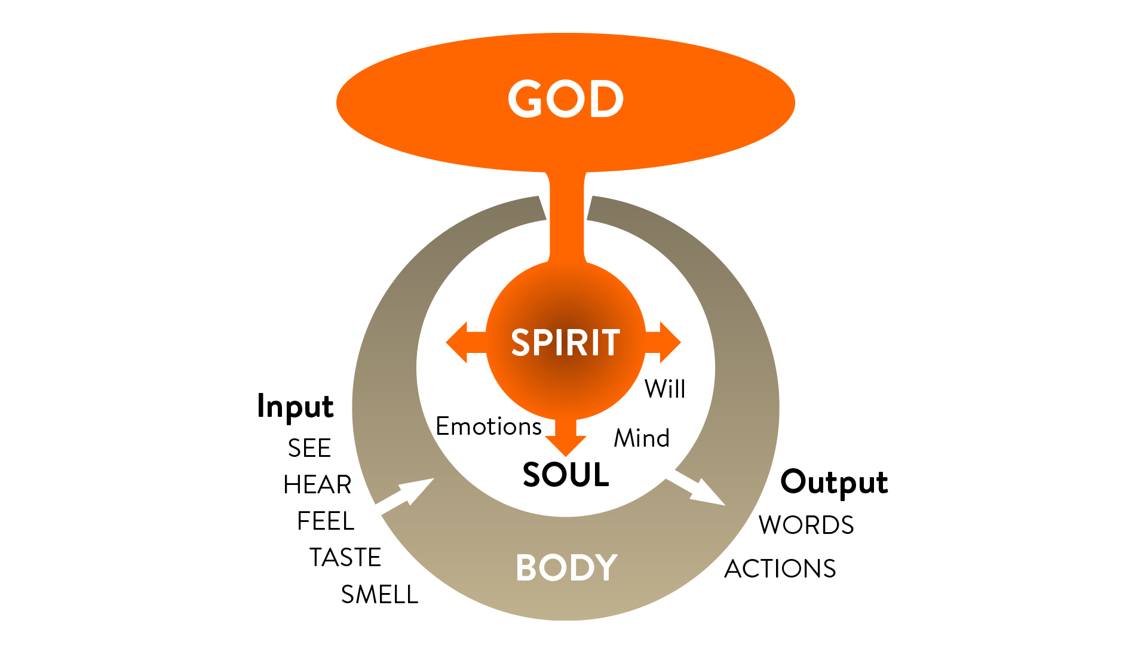
Notes:
This diagram represents Adam before he sinned.
He had fellowship with God.
His body was immortal.
He was innocent of sin.

Slide 7
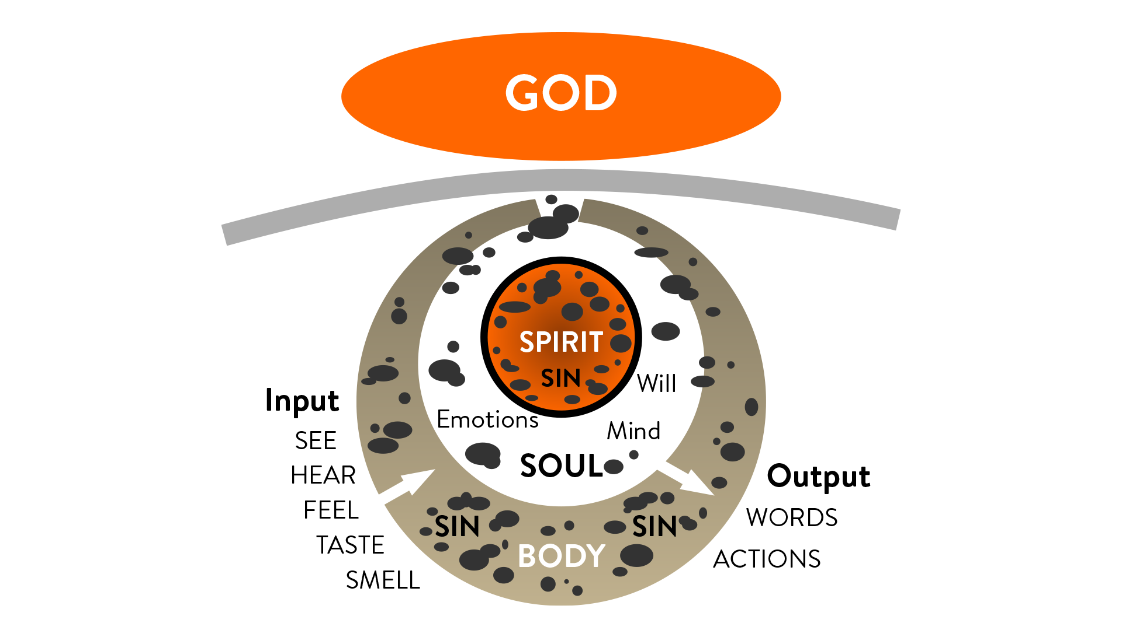
Notes:
This diagram represents Adam after he sinned. (and the whole human race)
We are separated from God by sin.
We are “flesh centered,” our body is the master.
Our body is aging and dying.
We know right from wrong. (conscience)

Slide 8
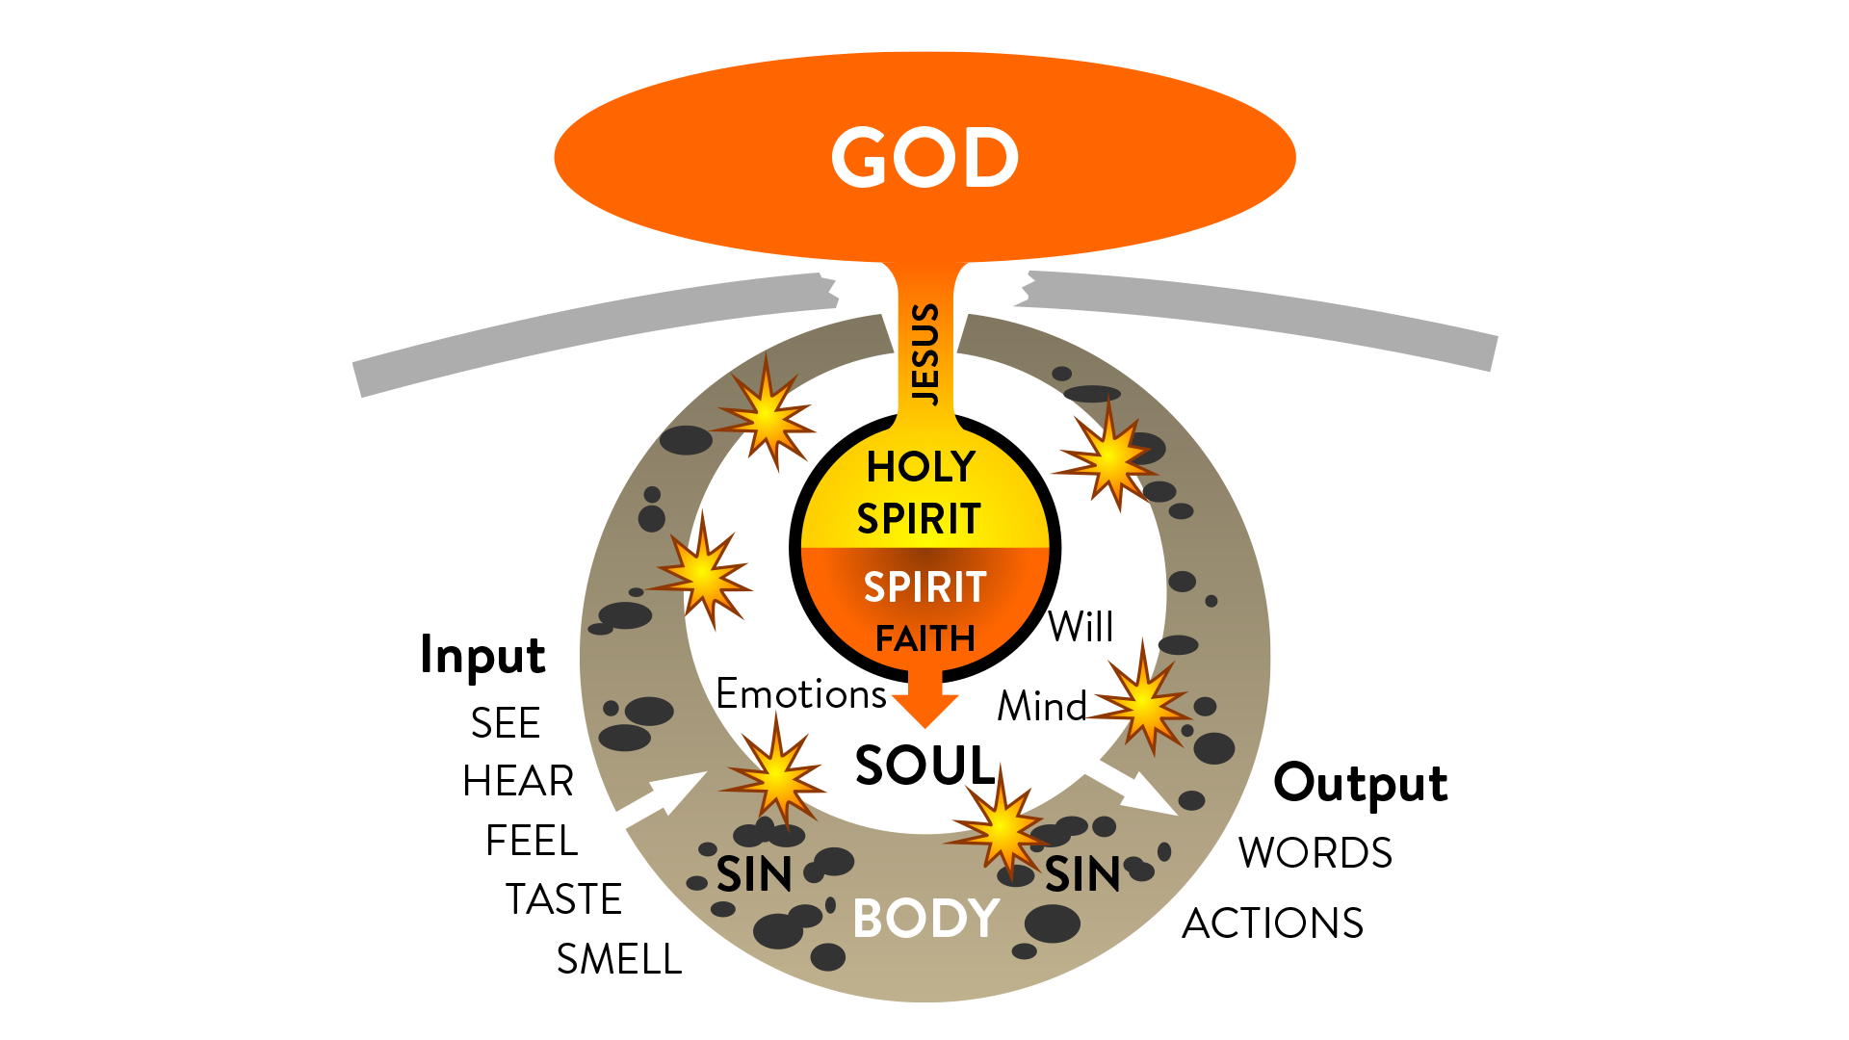
Notes:
This diagram represents a born again person:
We are reconciled or “re-connected” to God through Christ. (The Holy Spirit)
Our flesh and spirit fight for control.
Our body is still aging and dying.
We can receive from the Spirit through faith.
If we let the flesh control us, our soul will be corrupted.
If we let the Spirit control us, our soul will be renewed.
READ: Romans 8:1-14

Slide 9

We walk in the spirit through our thoughts, prayer, worship, study, fasting, and giving.
Notes:
As disciples, we should seek after spiritual things and work to put aside the sinful things our bodies desire.
There are three things the body wants:
The lust of the eyes: things that look good.
The lust of the flesh: things that make us feel good.
The pride of life: things that make us look good to other people.
So how do you walk in the spirit? There are several ways:
We walk in the spirit through our thoughts, prayer, worship, study, fasting, and giving.
Explain each one.

Slide 10
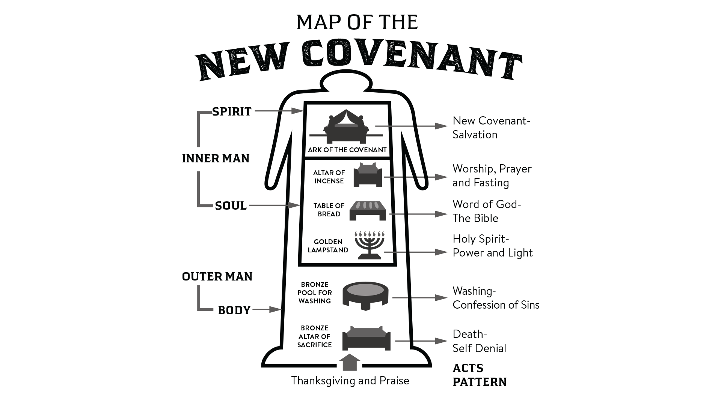
Notes:
Remember how we studied the Tabernacle pattern back in lessons 2 and 3?
The same pattern applies to our daily life as Christians.
The altar represents self-denial.
The pool represents confessing of sins.
The items in the Holy Place represent daily communion with God.
Lampstand- The Holy Spirit
Table of Bread- The Bible
Altar of Incense- Worship, prayer, and fasting
The Ark of the Covenant represents the Holy Spirit inside of us, writing His laws on our hearts and minds. (Hebrews 10:16)
Instead of a tabernacle, WE are now the temple of the Holy Spirit. (1 Corinthians 6:19-20)

Slide 11
There is a conflict between our sinful body and the Spirit of God that is in us.
Notes:
There is a conflict between our sinful body and the Spirit of God that is in us.
As a Christian, It is very difficult to handle moral failure. (sin)
Our flesh still desires sinful things.
Our spirit is renewed and desires righteousness.
This causes great conflict and frustration in the inner man, and can cause some to give up.
Gods grace helps us overcome sin and covers and protects us when we do sin.
READ: Romans 5:20-21

Slide 12
The Holy Spirit creates in us a deep desire to please God and gives us power to overcome sin.
Notes:
Some people think that grace makes it “okay” to sin.
That’s not true!
The Holy Spirit creates in us a deep desire to please God and gives us power to overcome sin.
If sinning doesn’t bother you, then you either don’t have the Holy Spirit, or you have suppressed it so long, you no longer feel it.
The Holy Spirit also gives us supernatural power to overcome and suppress our sinful nature.
(Tell your story of deliverance, or someone you know.)
When we overcome our desires to sin through the Spirit, spiritual growth takes place…

Slide 13
The process of growing to be a mature Christian takes time and effort.
Notes:
The process of growing to be a mature Christian takes time and effort.
It is wise to be patient with ourselves and others as we grow and overcome our weaknesses and sins in this life.
As we grow “fruit” is produced.
The results or “fruit” of the Spirit is: love, joy, peace, patience, kindness, goodness, faithfulness, gentleness, and self-control. (Galatians 5:22)

Slide 14
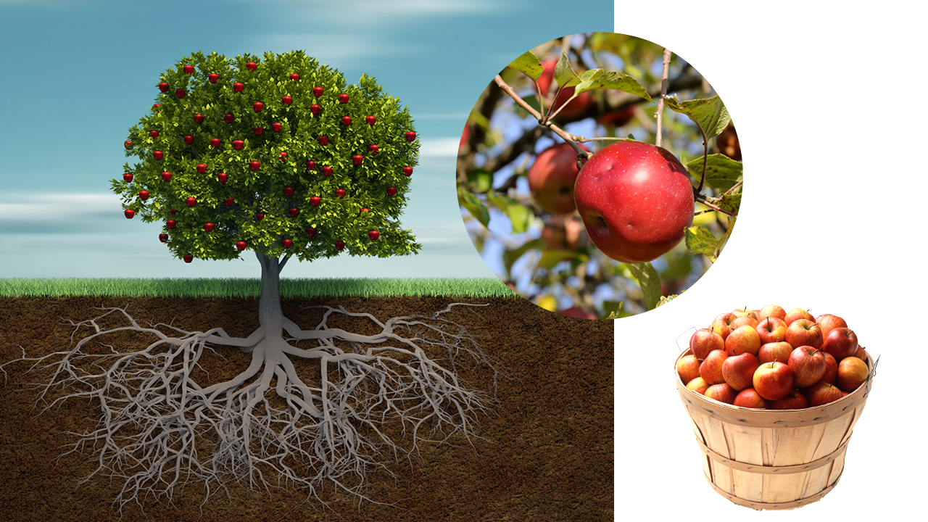
Notes:
The scriptures often compare us to trees:
Trees take time to grow.
Our roots are hidden in the ground.
Our root system supports us. (stability, foundation)
Our roots must be in the word of God, prayer, worship, and obedience when no one is looking.
The leaves on our tree are the visible aspects of our walk with God.
Fruit is the good works that we produce out of our walk with God.
Others enjoy the fruit that we produce.
Our church should be full of the fruit of the Spirit

Slide 15
Salvation is not attained by works, but through Jesus Christ and obedience to His plan.
Notes:
We should bear fruit as a result of our salvation, not as a way to attain salvation.
Salvation is not attained by works, but through Jesus Christ and obedience to His plan.
READ: Ephesians 2:8-10
God sees our true motives and intentions.
We can’t earn salvation, it comes from a genuine change of heart.

Slide 16
We need to be serious about our walk with God and make pleasing Him a priority.
Notes:
We need to be serious about our walk with God and make pleasing Him a priority.
God desires to be our purpose and passion in life.
He is not interested in religious duty to appear good to others.
READ: Philippians 2:12-15
We should be very concerned about showing the results of our salvation.
This will be a blessing to other believers in the church.

Slide 17
The church is described as the body of Christ on Earth.
Notes:
Have you ever wondered why Jesus had to leave?
Jesus said it was more beneficial for us that He go and return in the form of the Holy Spirit.
Read: John 16:7-8
When we are filled with the Spirit, we will do the work of Jesus Christ.
The church is described as the body of Christ on Earth.
The church was designed to do as a group what Jesus did as an individual.
The church has five different ministry roles: Apostles, Prophets, Evangelists, Pastors, Teachers.
READ: Ephesians 4

Slide 18
God gives spiritual gifts to individual believers to help the church.
Notes:
God gives spiritual gifts to individual believers to help the church.
A gift is a supernatural ability given to an individual to help the church:
Some of those gifts are:
Word of wisdom, word of knowledge, gift of faith, gift of healing, working of miracles, prophecy, discerning of spirits, different kinds of tongues, interpretation of tongues.
READ: 1 Corinthians 12
As Christians, we should should prayerfully seek to be used in these gifts.
(Give example of recent manifestation of the gifts.)

Slide 19
Satan uses false doctrine to try to corrupt and defeat the church.
Notes:
Why are there so many different religions and denominations?
In the dark ages, truth was suppressed.
As truth was restored, new denominations were formed with each revelation.
Satan uses false doctrine to try to corrupt and defeat the church.
READ: Jude 1:3-4
This is why studying the scriptures is so important.
Here are some examples of false doctrines:
Unscriptural teachings and traditions of men
Salvation earned by works, not grace.
Sin is permissible under grace.
Everyone will be saved, regardless of whether they obey the gospel.
It is very important that we stay alert at all times and are balanced in Spirit and Truth.

Slide 20
We are currently in a time of God’s grace and favor known as the Church Age.
Notes:
The last book of the Bible, Revelation, is a prophetic book that tells the future of the world.
So, what is going to happen in the future?
We are currently in a time of God’s grace and favor known as the Church Age.
God is not judging the world at this time.
This is the time of God’s grace and favor.

Slide 21
Those that are born again will take part in the first resurrection and be judged by God for what they did in His kingdom.
Notes:
Those that are born again will take part in the first resurrection and be judged by God for what they did in His kingdom.
At the end of the Church Age, God will gather all the believers that have died and are currently alive.
This is the first resurrection, also known as the “Rapture”.
All believers will stand before the Judgment Seat of Christ and be rewarded for what we did as Christians here on Earth. (Bema Seat)
Think about that moment. Do you want to receive a reward? (explain)
READ: 2 Corinthians 5:9-10
What will happen to those that reject God?

Slide 22
Those who reject God will take part in the second resurrection and be judged at the White Throne Judgment.
Notes:
Those who reject God will take part in the second resurrection and be judged at the White Throne Judgment.
After the first resurrection, there will be a terrible time of suffering and punishment for those on Earth.
The entire world will be deceived and follow a leader called the “Antichrist.”
In the end, Christ Himself will return again and defeat the Antichrist in the Battle of Armageddon.
Then there will be 1000 Years of righteousness, Satan is bound.
After the end of the 1000 years, the White Throne Judgment will be held.
God will judge all who have died in their sins.
This is the second resurrection of the dead.

Slide 23
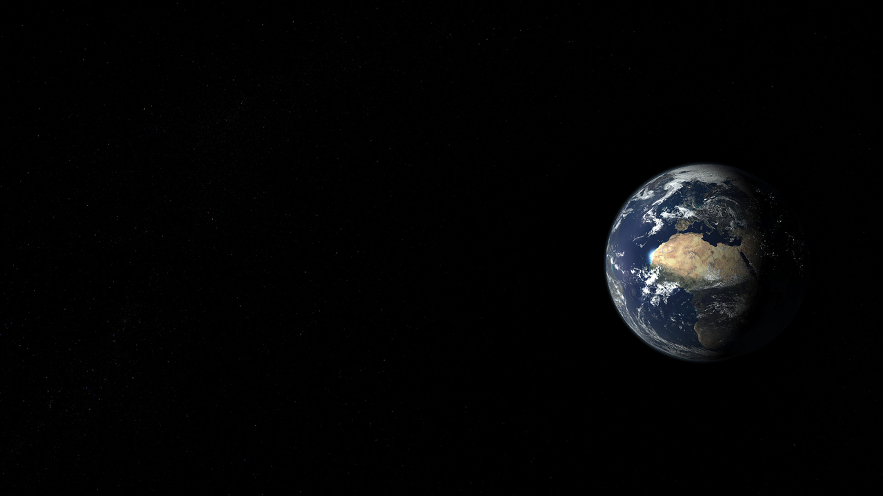
What are the signs of the end times?
Notes:
What are the signs of the end times?
READ: Matthew 24:3-14, 30-51
Are we in the end times? You be the judge.
We must be ready at all times, regardless.
Life is uncertain and could end at any moment.
Being aware and prepared for the afterlife is the most important thing you can do.

Slide 24
The final destination of those that obey the gospel is Heaven, a place of reward.
Notes:
So, what happens to people when they die according to the scriptures?
The final destination of those that obey the gospel is Heaven, a place of reward.
We will have new bodies to replace our old, sinful ones.
Heaven is not what popular culture has portrayed it to be.
1 Corinthians 2:9 says:
That is what the Scriptures mean when they say, “No eye has seen, no ear has heard, and no mind has imagined what God has prepared for those who love him.”
Heaven will be amazing!
But what about those that reject the Gospel?

Slide 25
The final destination for those who reject the Gospel is the Lake of Fire, a place of punishment and torment.
Notes:
The final destination for those who reject the Gospel is the Lake of Fire, a place of punishment and torment.
There are several words in scripture that are translated as “hell”:
Sheol/Hades- The grave. (place of the dead prior to judgment, conscience regret and discomfort)
Gahenna- The lake of fire. (final destination of Satan and the wicked after judgment)
READ: Revelation 20:11-15

Slide 26
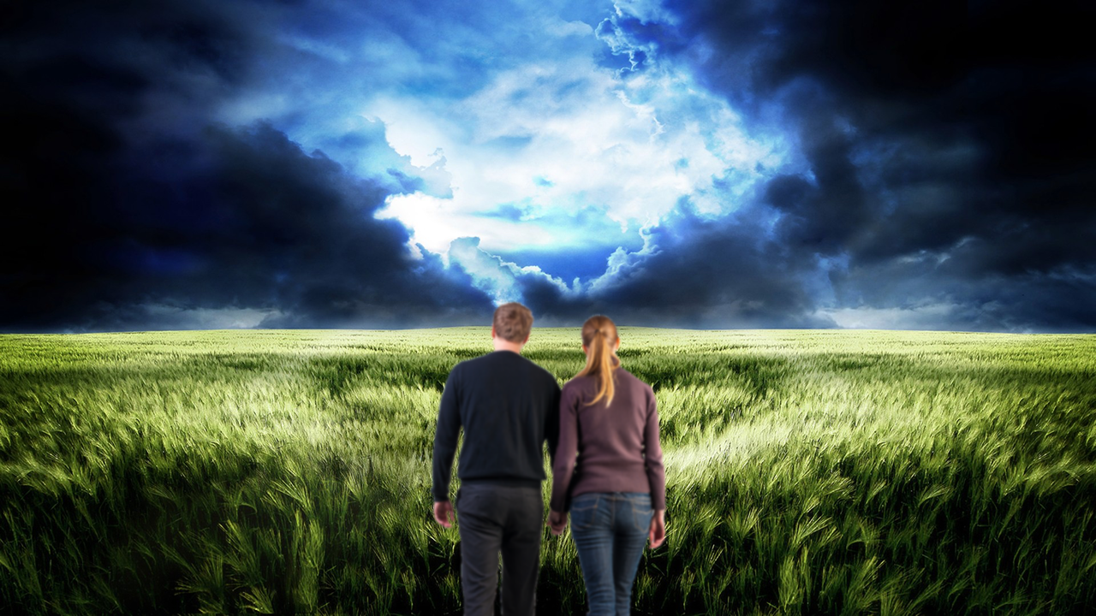
Notes:
At the beginning of this study we talked about truth.
Sometimes the truth is difficult to accept.
Many are uncomfortable discussing the afterlife.
If there was a terrible storm headed your way, wouldn’t you want to know so you could protect yourself and your family from disaster?
It would be foolish to ignore the danger.
The good news is that we are still living in the time of God’s grace and favor!
God had warned us in His word of the coming judgment, and provided a way of escape.
READ: Matthew 7:13-14
Here is the question: What will your response be?

Slide 27

Your Response
Notes:
If you are deciding now to believe this message and become a Christian:
Follow God’s plan and be born again.
(Make sure the student knows you are willing to pray with them or initiate baptism)
If you have already decided to follow Christ and been born again:
Be blessed and strengthened in your faith.
Dedicate yourself to spiritual growth.
Share this message with others.
If you still aren’t sure this is true:
Pray earnestly and ask God to show you what to do.
(Ask if there are any questions they need answered to help them make a decision.)
Closing Prayer

Slide 28
Notes:
Instructor note: Be sensitive to the leading of the Holy Spirit at the closing of this course. Some students will be open to conversation immediately, others will need time to process what has been said. It is important not to aggressively force a decision. You can always reconnect later and start the conversation.
Here are some questions you could ask if you feel that the time is right:
“What do you think of the Bible study?”
“Did I ever tell you my story about coming to Christ?”
“So, how are you doing spiritually?”
“If you believe, is there anything stopping you from being baptized?”

